Slide 1
Global Suicide Rates
Things we will go into detail:
Topic/Background
Resources used
Data information
Business Questions/Needs
Analysis
Conclusion
Next steps
Questions
Hosted By: David Jhang

Slide 2
Topic & Background
I wanted to study the trends to see if there was an impact to the financial markets from the subreddit group known as “WallStreetBets”.
Recent popularity over the subreddit group “WallStreetBets” in Jan of 2021.
Roughly 11 million subscribers.
“r/wallstreetbets”, also known as “WallStreetBets” or “WSB”, is a subreddit where participants discuss stock and option trading. It has become notable for its colorful and profane jargon, aggressive trading strategies, and for playing a major role in the GameStop short squeeze that caused losses for some U.S. firms and short sellers in a few days in early 2021 (Wikipedia).

Slide 3





Resources
“WallStreetBets” subreddit
GameStop Corp.
AMC Entertainment Holdings
Blackberry Limited

Slide 4
Data information
Historical Data was taken from the subreddit group known as “WallStreetBets”
Period was from 12/28/20 to 10/08/21.
Data was initially scrapped daily (by Alex Baransky).
‘post/comment mentions’, ‘predictive context count’ were the main highlights used.
Historical Financial Data was taken from “Yahoo Finance”
Period was from 12/28/20 to 10/08/21.
Scrapped data based individual “ticker” which are official stock identifiers for companies.
Daily and Monthly data was taken.
Closing Price, Adjusted Closing Price and Volume were the key metrics.

Slide 5
Business Questions/Needs
There was a huge short squeeze on these stocks early in 2021. Many funds (most noticeably Melvin Capital) lost 30% of it’s value and 53% of it’s investment by the end of Jan 2021.
Impacted hedge funds on the type of stocks they could short without the risk of having it blow up in their face. A large portion of funds went from having a diverse short portfolio to using an index for diversification reasons. (unforeseen portfolio risk)
Could be another tool for investment professionals to use when looking at potential investments.
How much impact is it having? How effective are these subreddit traders?
A need to quantify and measure impact.

Slide 6
Analysis
I wanted to first determine the # of ‘mentions’ based on each stock for the period
Mentions = # of times mentioned in any posts or comments (daily).
Period was from 12/28/20 – 10/8/21.
This included positive and negative sentiment.
Discover which are the top 3 stocks.
To repeat Step 1 using another metric to reinforce the top names:
Used daily “positive count” and “negative count” = # of times stock was mentioned in in a positive or negative context (predictive).
Compare and narrowed down the top 3 names for further analysis.
Breakdown of the top 3 names
Wanted to focus on which months had the highest mentions.
See the corresponding volume for that monthly period.
Also wanted to see the price movement for that period.

Slide 7
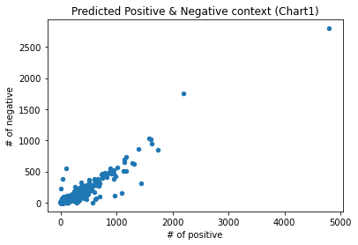
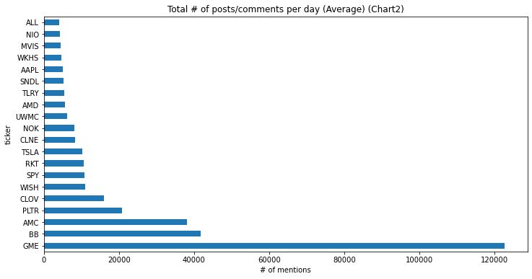
Outliers and Analyzing the reddit data
I wanted to first look at the daily data for the period.
Localize any outliers in particular stocks based on their popularity.
I measured popularity based by daily posts or comments (mentions) over the course of the period. (Chart 2)
I also wanted to highlight outliers from the context of the text (both positive and negative) – (Chart 1).
Chart 1 shows just how big the gap the most popular names are from the rest of the group.
Chart 2 – GME, BB and AMC seem to the top names mentioned on WSB.

Slide 8
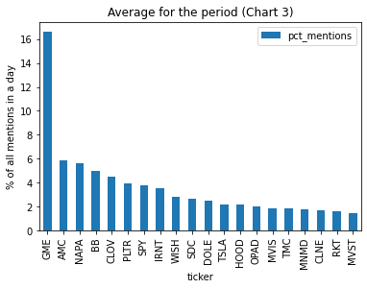
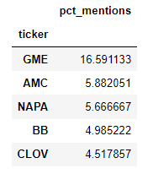
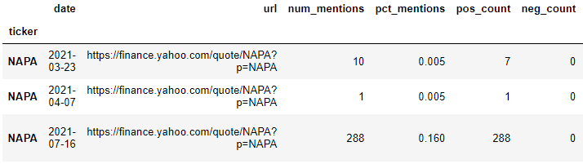
Repeating the first step differently:
I focused this time on the positive and negative counts for each day.
This is any time the stock was mentioned using a predictive model to determine positive or negative context.
Chart 3 represents the top names. Once again GME, AMC, BB are in the top 4.
NAPA was ranked 3rd on the list. NAPA is a Napa Winery that IPO’d in March of 2021.
Further investigation shows only 3 data points for NAPA which is why the stock resulted a high mean. (Discarded from consideration)
GME (Gamestop), AMC (AMC Theaters), BB (Blackberry) were chosen for further analysis.

Slide 9
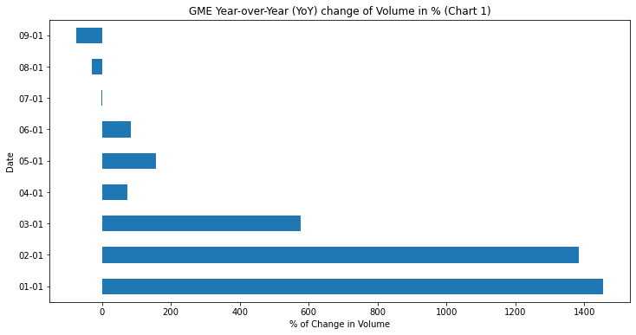
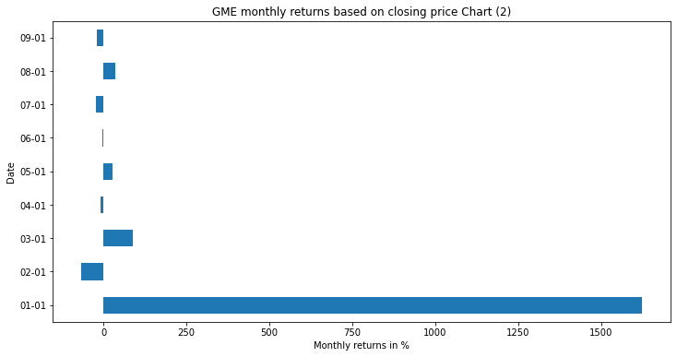
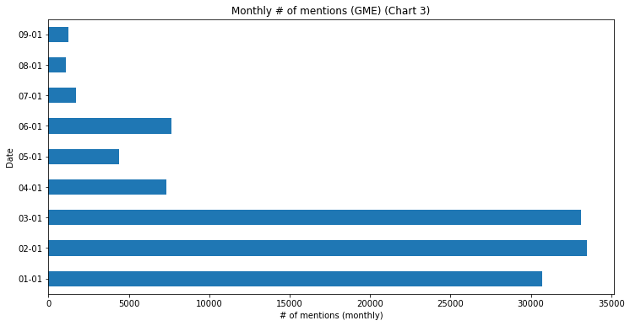
Gamestop (Monthly Breakdown)
Chart 1 -shows Year-over-Year (YoY) change in volume
by month (in %)
Chart 2 - shows monthly return on investment (in %)
Chart 3 - shows the “# mentions” by month
Volume was strong in Jan and March mainly.
And dies down for the last 3 months, volume actually is negative YoY.
Price movement mainly captured in January of 2021.

Slide 10
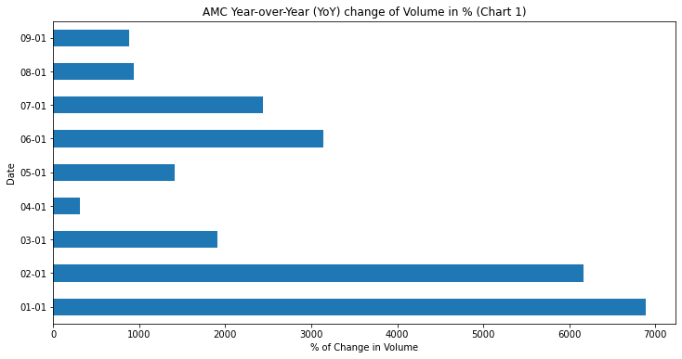
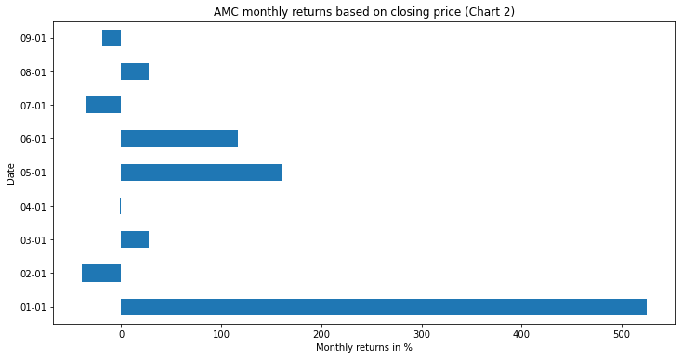
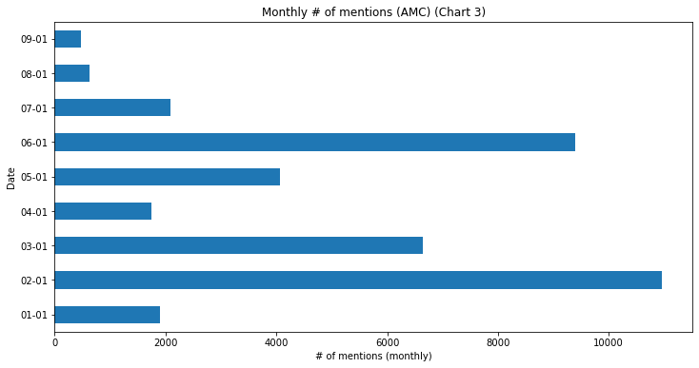
AMC (Monthly Breakdown)
Chart 1 -shows Year-over-Year (YoY) change in volume
by month (in %)
Chart 2 - shows monthly return on investment (in %)
Chart 3 - shows the “# mentions” by month
Volume was strong in Jan and Feb 2021.
Small pickup in June 2021 and July 2021.
Price movement mainly captured in January of 2021. (outlier)
Out of all the 3 stocks, this has more mentions by a monthly basis than the other 2.
Volume is elevated in those months.

Slide 11
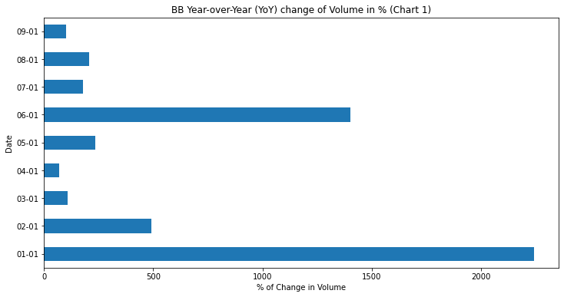
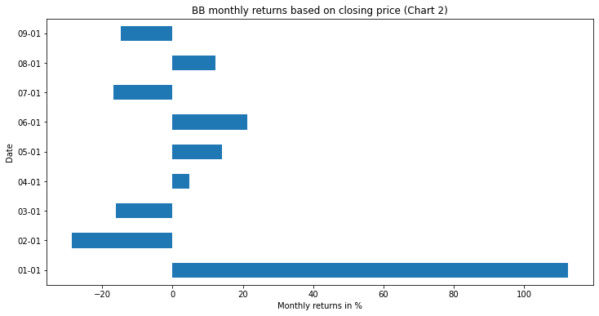
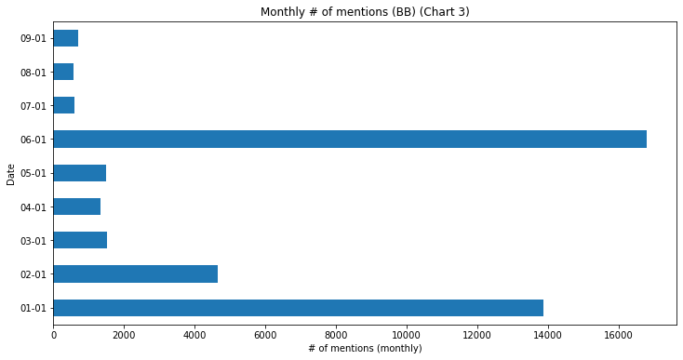
Blackberry (Monthly Breakdown)
Chart 1 -shows Year-over-Year (YoY) change in volume
by month (in %)
Chart 2 - shows monthly return on investment (in %)
Chart 3 - shows the “# mentions” by month
Volume was strong in Jan 2021.
Volume also elevated in June 2021.
# of mentions also strong in June 2021.
Price movement mainly captured in January of 2021.

Slide 12
Conclusion
Increase in overall trading activity.
Potential correlation to the amount of mentions in the posts or comments to the trading volume of these stocks.
Most of the price appreciation was realized in the 1st month where the # of mentions increased. (AMC did not but did the following month)
Price doesn’t appear to move in the same magnitude after the initial move.
Doesn’t appear to correlate with the price of the stocks.
Volume and mentions have died down the past couple months (one-time event?)
Potential reasons why price didn’t have relation to the # of mentions:
Reddit members can be talking about the stock without trading it.
Some members can potentially be shorting the stock (via puts) or selling their stake (profit-taking).
Company could take advantage of the stock price and for example, issue more shares which would naturally depress the price of the stock.
Market capitalization (how big the company is worth by dollar value) increased dramatically after January.
This means it would be harder to move the stock price because you would need a lot more money to have the same impact before the price appreciation

Slide 13
Next Steps
Further analysis can be done with the price to the # of mentions (mainly that 1st month move)
Better data is available to use than Yahoo Finance
Bloomberg terminal services provides real-time exchange prices and option data.
This potentially can provide daily to intraday analysis to the prices and options markets with the WSB data.
Considering options is another way to trade stocks, more analysis can be done around option expiration dates.
Also provides “short interest” metrics (how many share are shorted) to better understand the types of stocks are attractive to the subreddit. (most of these names had high short interest)
This in conjunction with the WSB data and market capitalization could help generate a list of names that may be attractive to WSB members to target

Slide 14
Questions?

